Slide 1
The Process Negligence and Civil Court
Student’s Name
Institution

Slide 2
Documents for taking action
Categories
Start of Action
Complete a notice claim and attach a court copy, claimant copy, two defendant copy and a service copy (Saumier, 2020).
Filing a Certificate of Service
ii. Throughout
Issue affidavit of service
iii. Civil Resolution Tribunal
Issue a notice of civil tribunal claim

Slide 3
Documents for taking action Con’t
iv. Mediation
Issue notice to mediate for claims
v. Judgment
Apply for default order
vi. Enforcement
Affidavit in support of garnishing order
See: http://www.smallclaimsbc.ca/court-forms#mediation

Slide 4
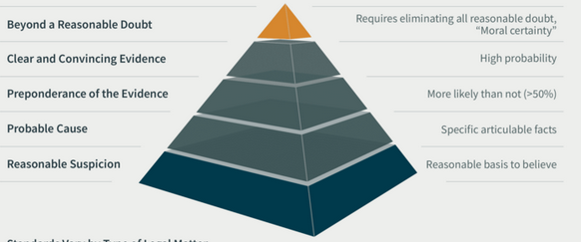
Provide a Reasonable Proof

Slide 5
Documents required to defend action
Filing a response to a notice claim
Completing a response to the civil claim
Issue a counterclaim against the plaintiff or any other party related to the lawsuit
Filing your documents including a copy of your file, one copy of each plaintiffs and original of the court registry (Baglay, 2020).
Serving the documents to the plaintiff by including an extra copy of the cover letter and ask receipt on the copy of the letter from the plaintiff

Slide 6
Special Types of Negligence
A store owner who fails to install “Caution: Wet Floor” sign after mopping a room. It shows that he voluntarily ignored putting a signage and a person who has skidded and hurt oneself can use this as cause of negligence and consider suing him.
An owner of a proper who fails to replace the rotten wooden porch which collapses and a visiting guest gets injured. The property knowingly ignored replacing the rotten wooden porch and this resulted in injury sustained by the visiting guest.

Slide 7
Special Situations for Certain Liabilities
An example of a strict liability is product liability whereby manufacturers produce defective products which are faulty and substandard
An example of vicarious liability is when an employer is held liable for the actions of his or her employee (Epstein, & Sharkey, 2020).
Engaging in abnormally dangerous activities in the neighborhood of other people can warrant imposition of a strict liability

Slide 8
Intrusion into another person’s land with livestock denotes that the consent of the owner of the land was not requested
Owning wild animals without the consent of the relevant institutions can be subject to litigation as the animals may harm others in the community
Parents are held responsible for the negligent actions of their children

Slide 9
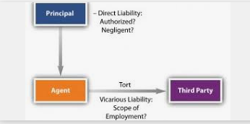
Tort Law

Slide 10
References
Baglay, S. (2020). Access to Compensation for Trafficked Persons in Canada. Journal of Human Trafficking, 1-30.
Epstein, R. A., & Sharkey, C. M. (2020). Cases and materials on torts. Aspen Publishers.
Saumier, G. (2020). Choice of Court Agreements in Common Law Canada. In Optional Choice of Court Agreements in Private International Law (pp. 137-149). Springer, Cham.

